Slide 1

Project Phase I Presentation Brain Tumour Detection System Presented by Ishan Modi (N18018) Ishan Srivastav (N18068) Janhavi Panambor (N18057) Guided by DR. VARSHA DEGAONKAR
Dept. of Electronics and Telecommunication
Hope Foundation’s
International Institute of Information Technology Hinjawadi Pune

Slide 2
Outline
Introduction
Literature survey
Problem statement and Objectives
Proposed Methodology
Requirement analysis
Impact analysis
Professional Ethical practices to be followed
Results
Conclusion and Future Scope
References

Slide 3
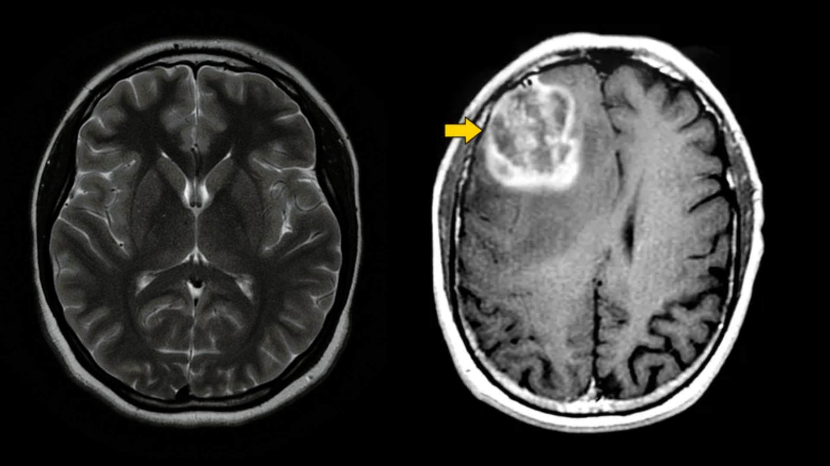
Introduction
The smart detection system operates on the AI algorithm.
It is based on feature extraction.
Early Detection of ‘Brain Tumor’.
Reduction of cost
Fig 1.- MRI Scan (researchgate.com)

Slide 4
Literature survey
Research paper title | Method | What paper suggests?
[1]Brain Tumor Detection Using Deep Learning | Deep Learning | Brain Tumor detection using CNN models with respect to the Training Dataset.
[2]Image Processing Techniques for Brain Tumor Identification | Image Processing | Suggests various methods to identify the Brain Tumor including it’s consequences.
[3]Brain Tumor Detection and Classification on MR Images by a Deep Wavelet Auto-Encoder Model | Deep Wavelet Model | Tumor detection using, Deep Wavelet Auto-Encoder Model with a different approach.

Slide 5
Literature survey
Research paper title | Method | What paper suggests?
[4]Brain Tumor Detection using Image Processing | Image Processing | Tumor is detected using Image processing.
[5]Brain tumor segmentation based on deep learning and an attention mechanism using MRI multi‑modalities brain images | Image Segmentation | A difference In the Brain cells is detected using Deep Learning and region detection (The affected part).

Slide 6
Problem statement and Objectives
Problem statement
To detect brain tumor using Deep Learning algorithms and implement the same into a web application that will act as an end product. The system being developed aims to facilitate early detection of tumour so as to reduce mortality rates.
Objectives
To reduce human intervention using automation of tumour detection.
To increase awareness about the “Brain Tumor”, by providing information modules on the web application.
Reduction of medical cost by early detection and diagnosis.

Slide 7
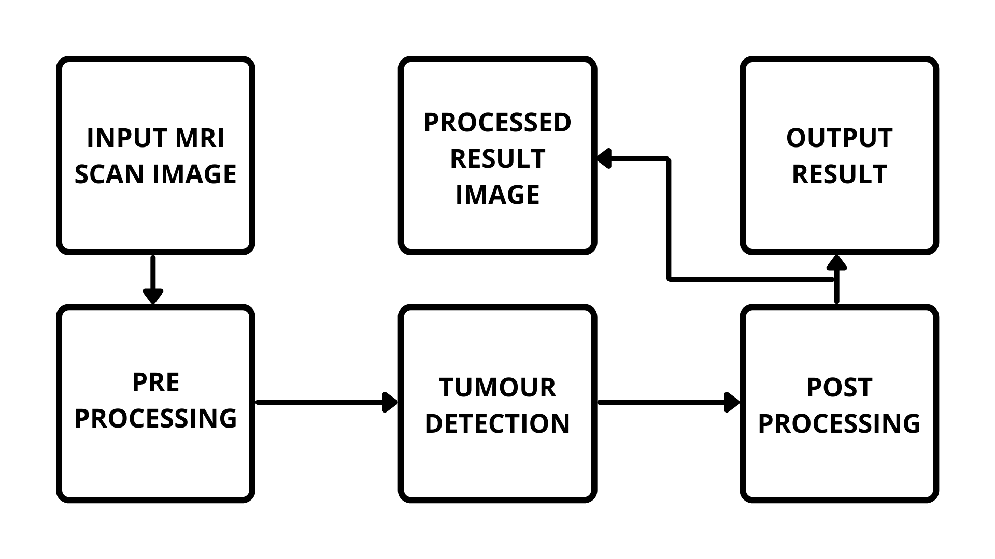
Proposed Methodology
Fig 2.- Proposed Block Diagram

Slide 8
Proposed Requirement analysis
Software Requirement
OS Requirement
Windows 8/10
Linux
Training of the model
Python IDE (Kaggle Notebook Editor)
Dataset for Training
Web Application

Slide 9
Proposed Requirement analysis
Hardware Requirement Basic Hardware for Training Purpose
RAM : 8 GB
ROM : 2 GB
Processor : i5 Processor
Limitations:
Limited detection due to less datasets being used in training.
Accuracy of Dataset is an important factor. Unverified datasets can lead to false results.
The detection model in it’s base form cannot provide accurate results on MRI captured using higher tesla MRI Machines.

Slide 10
Impact analysis
On Society
Positive Impact
Early detection may reduce Human Mortality Rate.
The system is affordable and easy to handle.
Negative Impact
It has a risk of errors and unplanned detection of false results.
It has a risk of undetected Initial stages due to small size.

Slide 11
Impact analysis
On Environment
Positive Impact
Less Bio Medical waste is generated due to early detection and treatment.
Negative Impact
Bio Medical waste generated during treatment after the detection of tumor is done through this system, if not treated properly can pose environmental risks.

Slide 12
Professional Ethical practices to be followed
Giving credits.
Keeping technical guidelines in mind.
Following the norms of engineering Practices.
Liability for outcome caused by one’s actions or decisions.

Slide 13
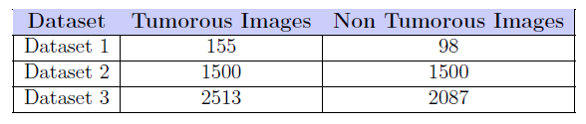
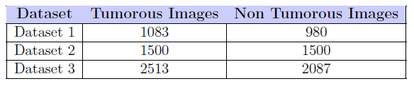
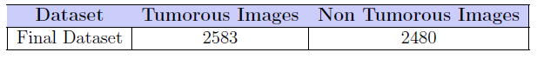
Results
Table 1.- Number of images in each dataset before augmentation
Table 2.- Number of images in each dataset after augmentation
Table 3.- Number of images in the final dataset after merging

Slide 14
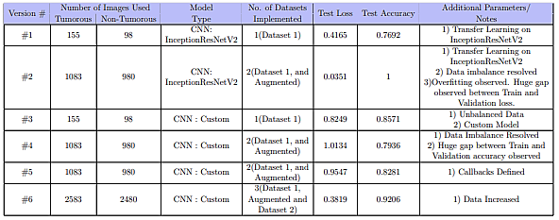
Results
Table 4.- Results obtained from each version

Slide 15
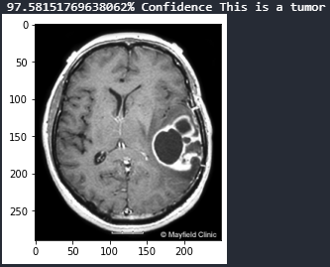
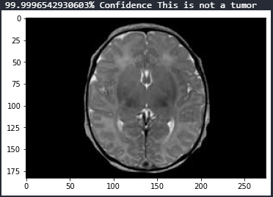
Results
Fig 3.- Presence of Brain Tumor
Fig 4.- Absence of Brain Tumor

Slide 16
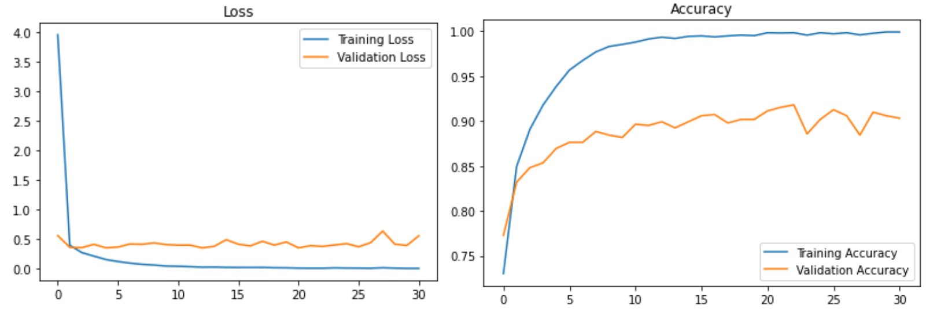
Results
Fig 5.- Loss and Accuracy Graph

Slide 17
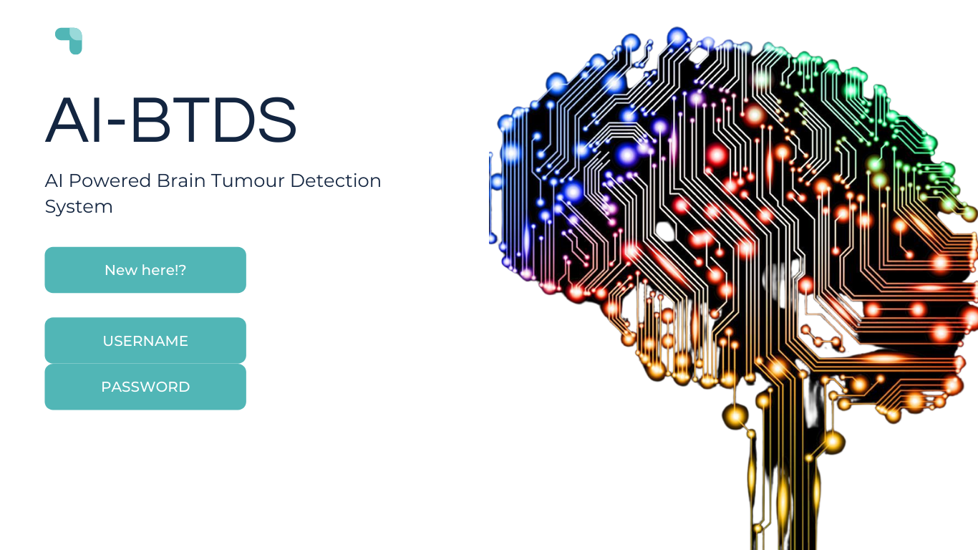
Proposed web Layout
Login Page

Slide 18

Proposed web Layout
Fact of the Day Page

Slide 19
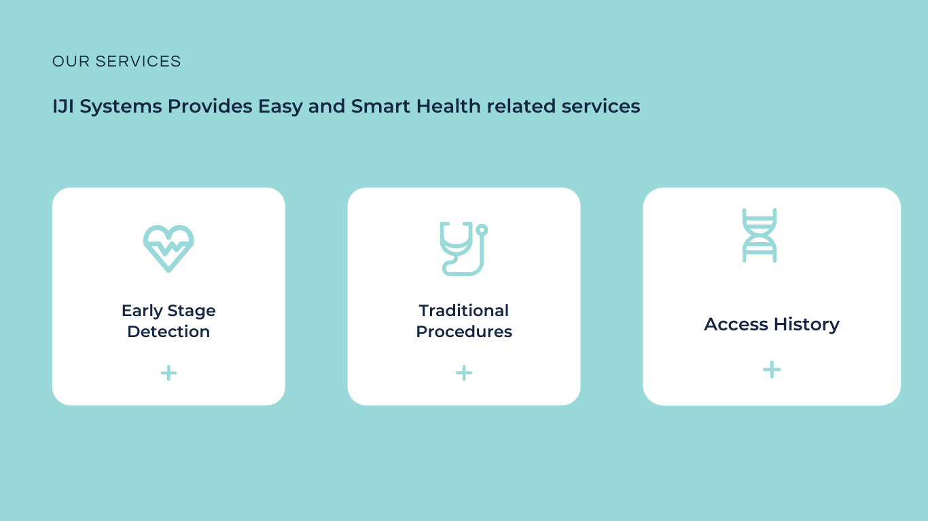
Proposed web Layout
Our Service Page

Slide 20
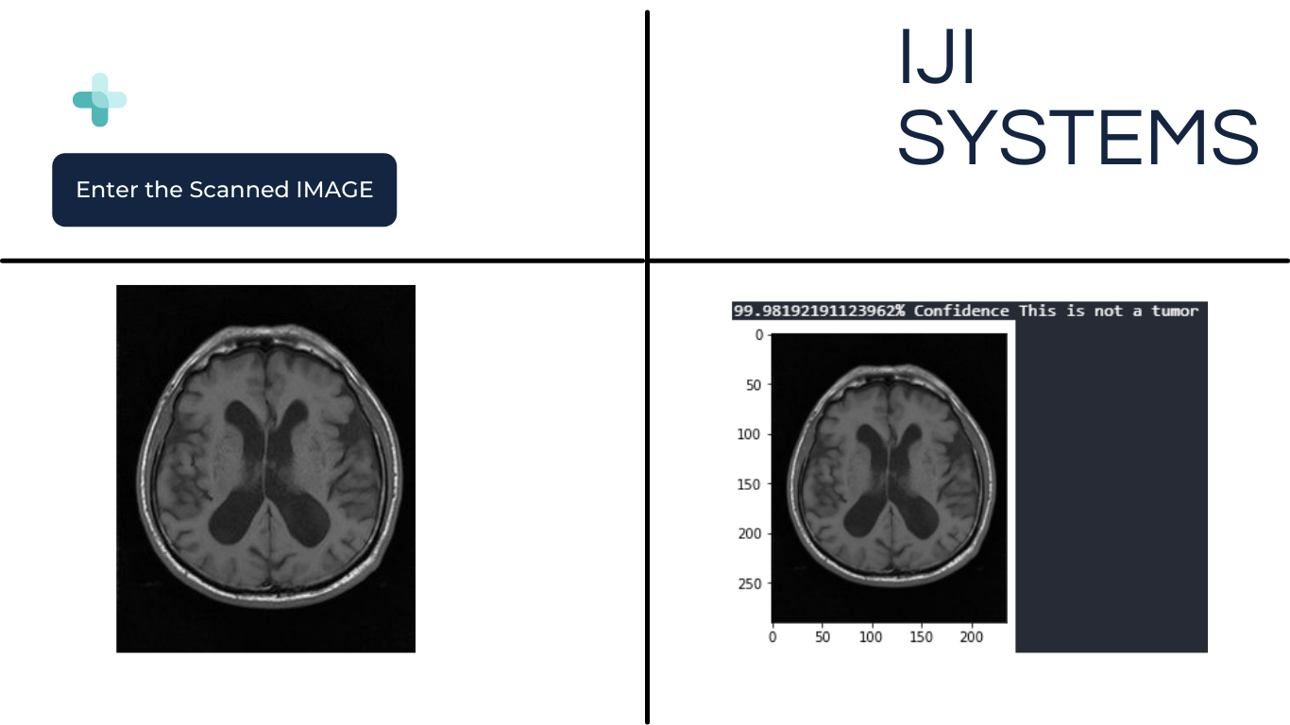
Proposed web Layout
Detection System Page

Slide 21

Proposed web Layout
Contact and Details page

Slide 22

Proposed web Layout
Contact and Details page

Slide 23
Conclusion
Implementation of a Deep Learning Model which detects whether there is brain tumor present or not is observed. A system accuracy of 92% is achieved on the trained model. Input image is passed onto the trained model which then determines whether image contains tumour or not. As per the inference by the model the output will be displayed on the web application accordingly.

Slide 24
Future Scope
• The particular trained model can be further trained to detect tumor of initial stages.
• The particular model can be trained further to detect which type of brain tumour is present inside the body.
• The system in its base form can be trained further to detect the tumour even more efficiently

Slide 25
Future Scope
• The entire Web Application can be further developed to understand more types of human body scans such as X-ray, CT - Scans etc. So as to become a full fledged health assessment portal.
• Such web application could be installed at hospitals which will then connect patients and the hospital staff virtually.
• The system can be upgraded to detect more types of tumours such as ovarian, breast, skin, lung tumours etc.

Slide 26
Reference Papers
Brain Tumor Detection Using Deep Learning by Avigyan Sinha , Aneesh R P , Malavika Suresh , Nitha Mohan, Abinaya D, Ashwin G Singerji
Image Processing Techniques for Brain Tumor Identification, by Nandita Goyal and Dr. Bharti Sharma
Brain Tumor Detection and Classification on MR Images by a Deep Wavelet Auto-Encoder Model by Isselmou Abd El Kader , Guizhi Xu , Zhang Shuai, Sani Saminu, Imran Javaid, Isah Salim Ahmad and Souha Kamhi
Brain Tumor Detection using Image Processing by Saurabh Kumar , Iram Abid , Shubhi Garg , Anand Kumar Singh , Vivek Jain.
Brain tumor segmentation based on deep learning and an attention mechanism using MRI multi‑modalities brain images by Ramin Ranjbarzadeh , Abbas Bagherian Kasgari , Saeid Jafarzadeh Ghoushchi , Shokofeh Anari , Maryam Naseri , Malika Bendechache

Slide 27
Thank You

